Slide 1
TD-DFT exercise
MHG group
UC Berkeley
Thursday, February 9th 2023

Slide 2
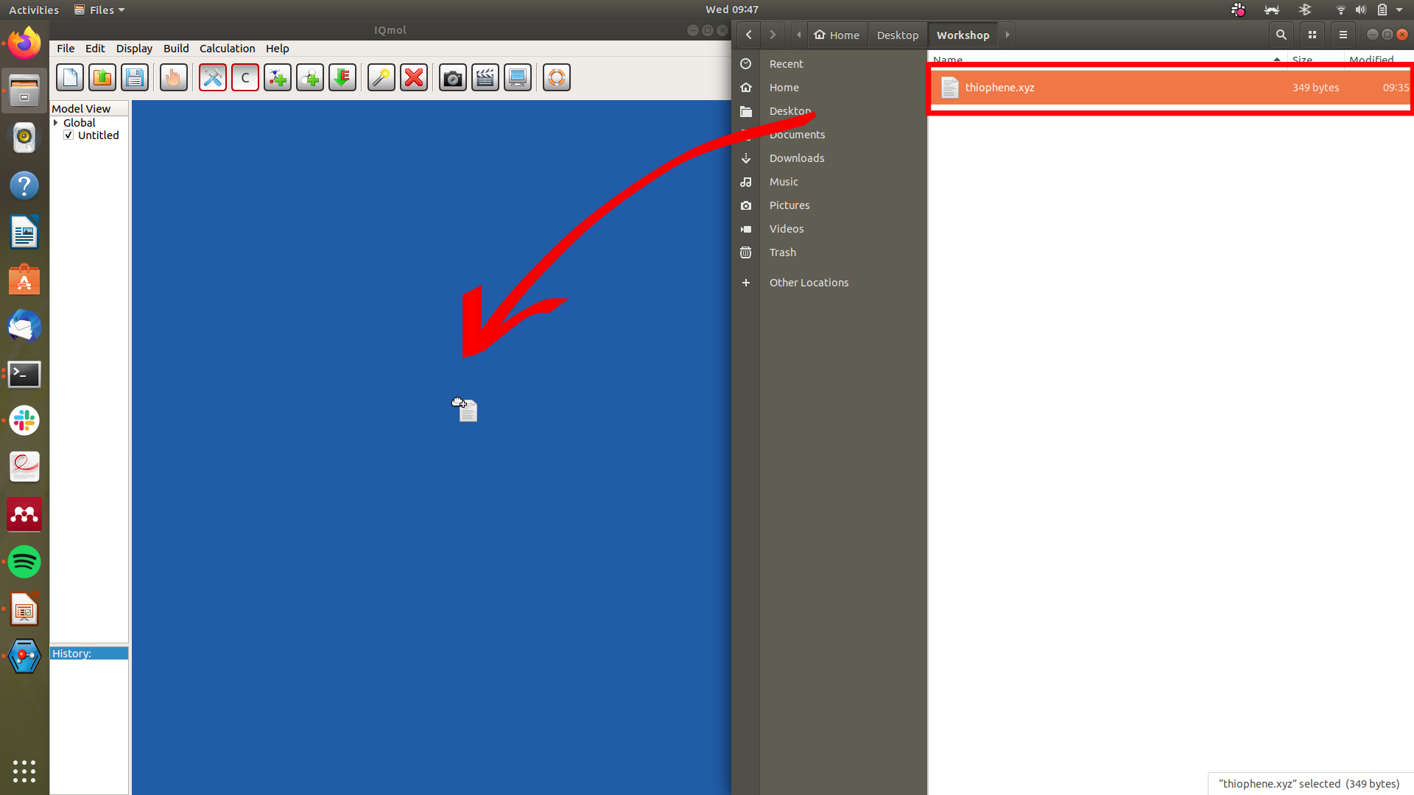
TD-DFT: thiophene
Drop the thiophene.xyz file into IQmol
‹#›

Slide 3
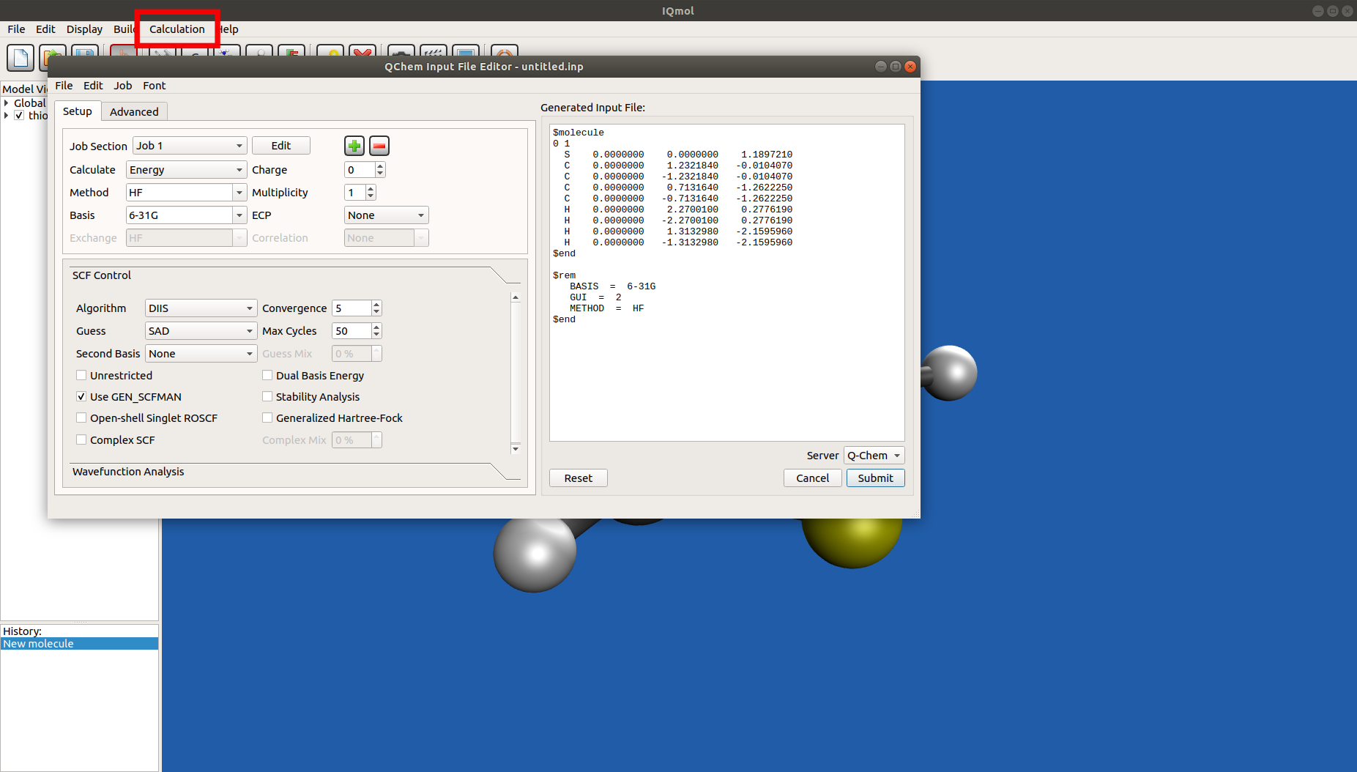
TD-DFT: thiophene
Open the Q-Chem job set up.
Top menu.
Calculation →Q-Chem Setup
“QChem Input File Editor” window should open up.
Tip: shortcut is Ctrl + U
‹#›

Slide 4
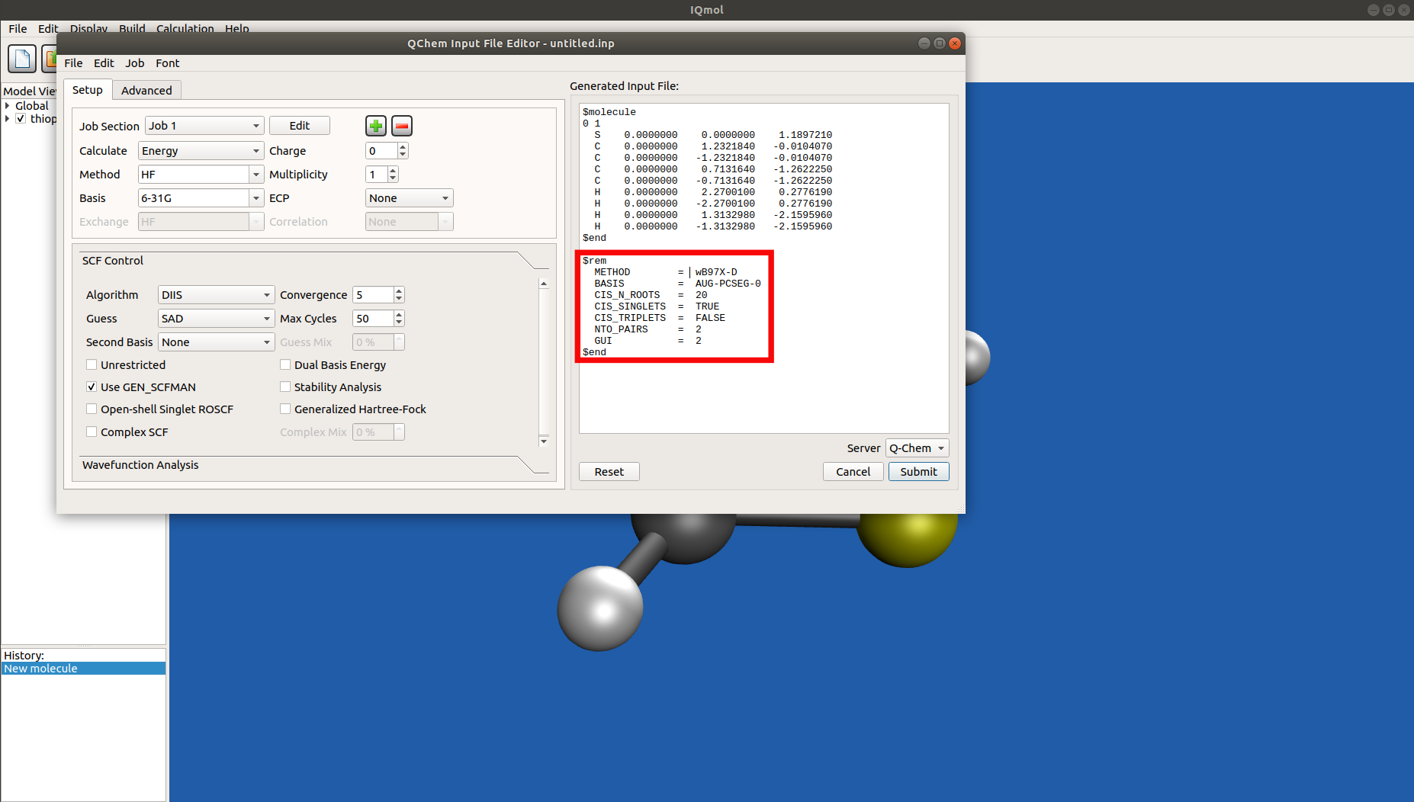
TD-DFT: thiophene
Palmer et al. Chem. Phys. 1999, 275.
Manually modify the $rem section to include:
METHOD = wB97X-D
BASIS = AUG-PCSEG-0
CIS_N_ROOTS = 20
CIS_SINGLETS = TRUE
CIS_TRIPLETS = FALSE
NTO_PAIRS = 2
GUI = 2
Tip: ordering of $rem variables does not matter.
‹#›

Slide 5
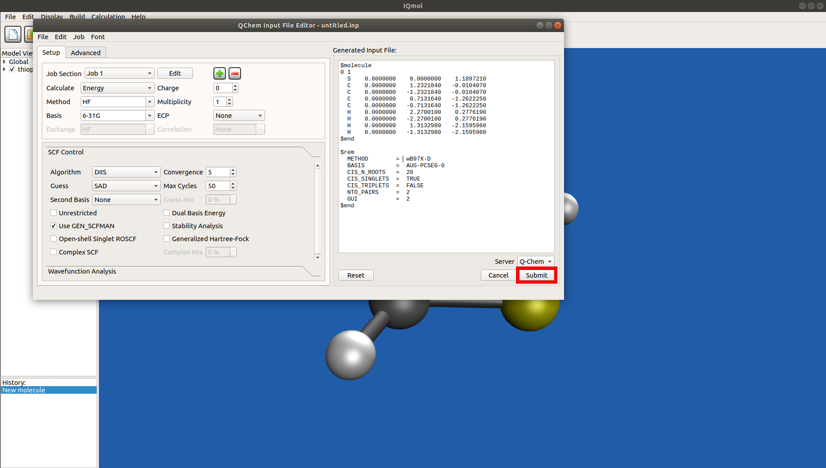
TD-DFT: thiophene
Submit the job.
Click submit
Give the job a name
Click OK.
Tip: Ctrl + J to monitor job.
‹#›

Slide 6
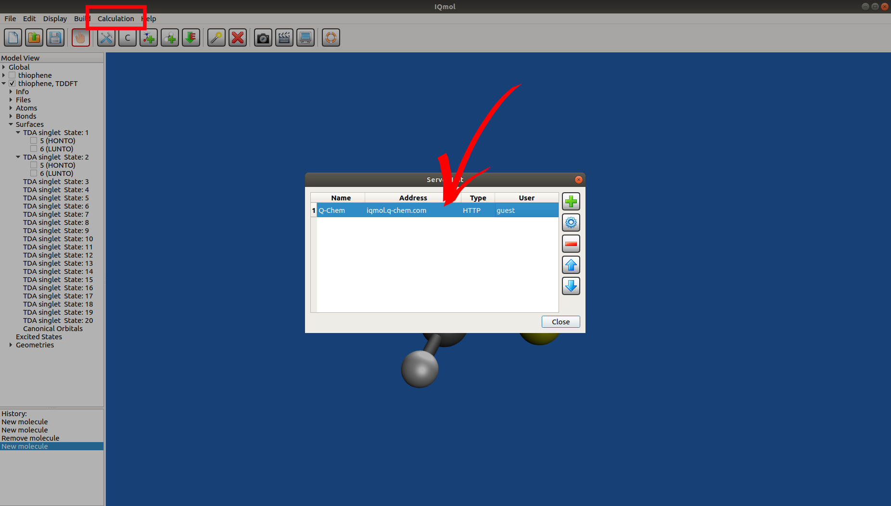
TD-DFT: thiophene
Got an error? Check HTTP connection to Q-Chem server.
Click on “Calculation” → “Edit server”
Double click anywhere on the row on the server list window
‹#›

Slide 7
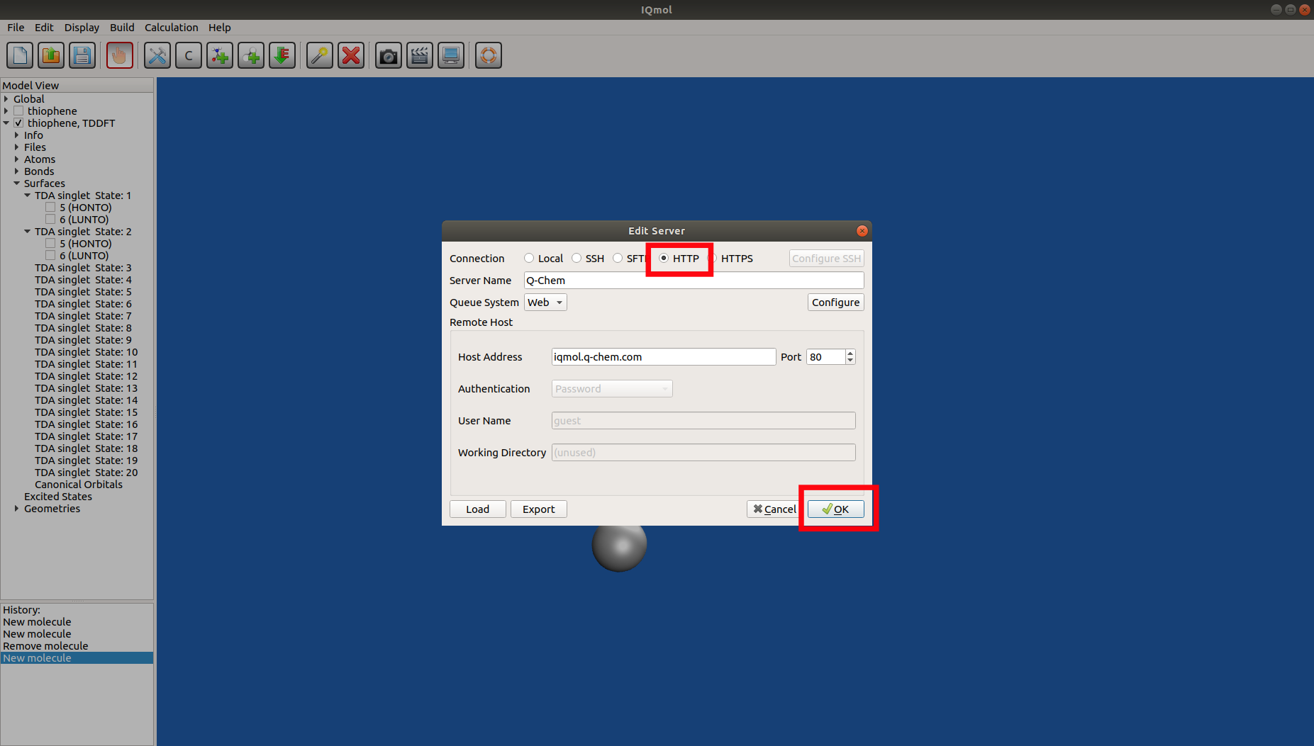
TD-DFT: thiophene
Got an error? Check HTTP connection to Q-Chem server.
Click on “Calculation” → “Edit server”
Double click anywhere on the row on the server list window
Select HTTP and click Ok
Go back to step 2
‹#›

Slide 8
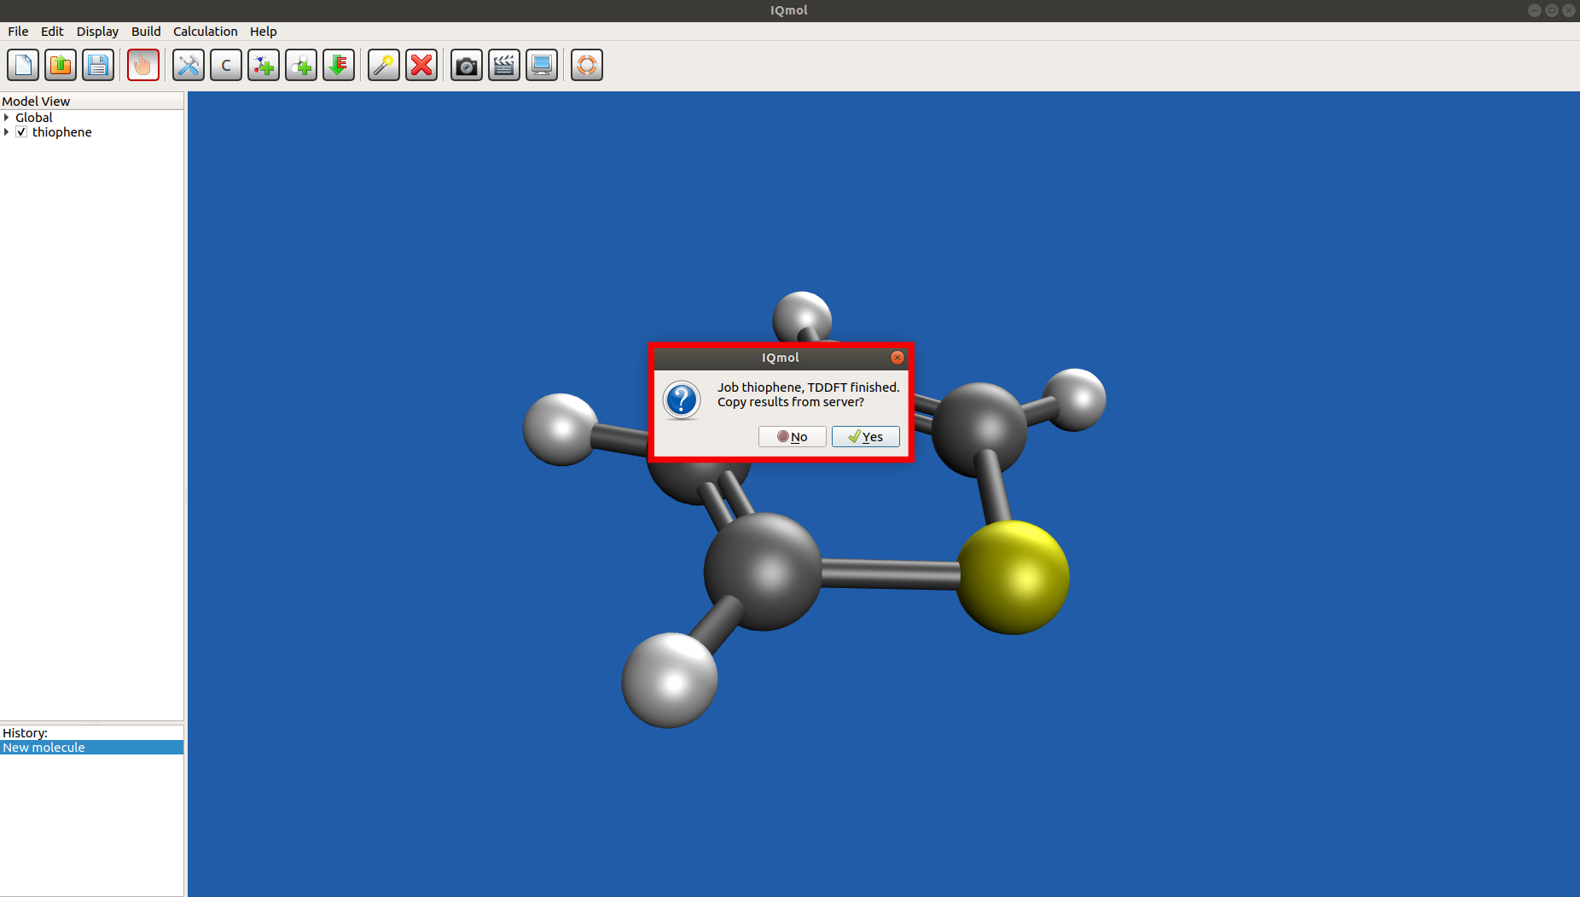
TD-DFT: thiophene
Save the results.
Create a new empty folder
Click open
Tip: a yellow star should appear next to your job on left panel once finished
‹#›

Slide 9
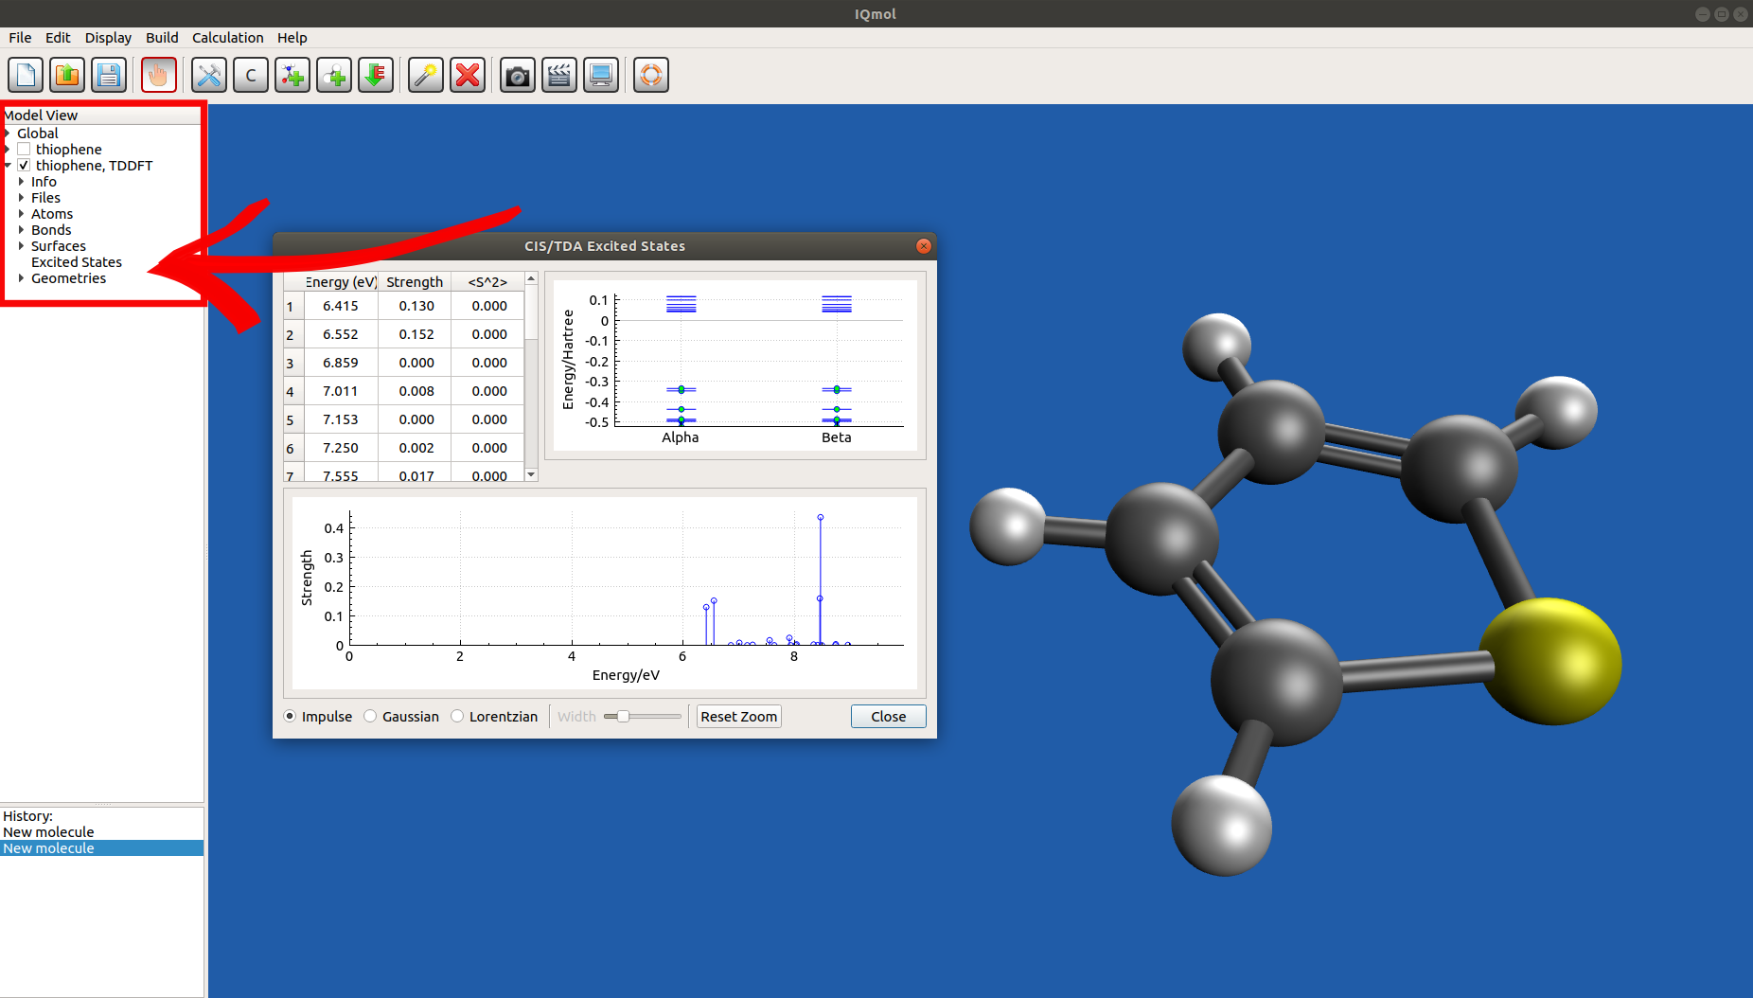
TD-DFT: thiophene
View the spectra.
Check the box of your results
Click on the drop down menu
Click on “Excited States”, under “Surfaces”
‹#›

Slide 10
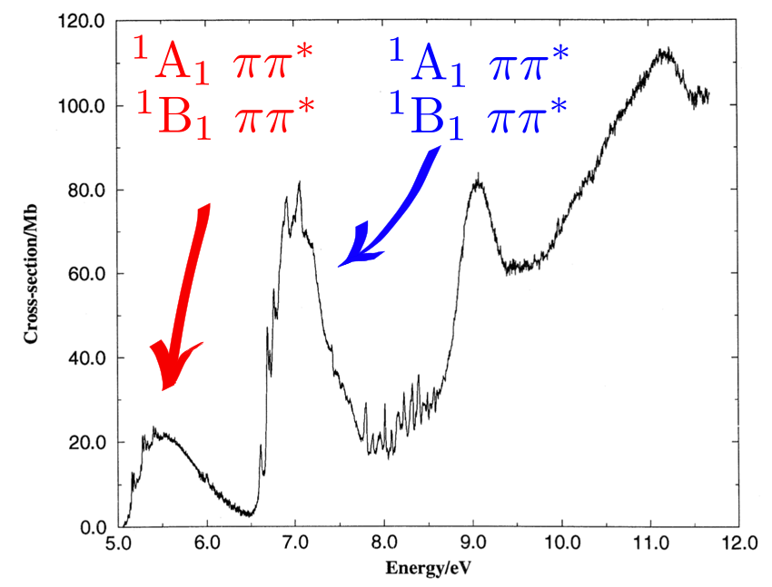
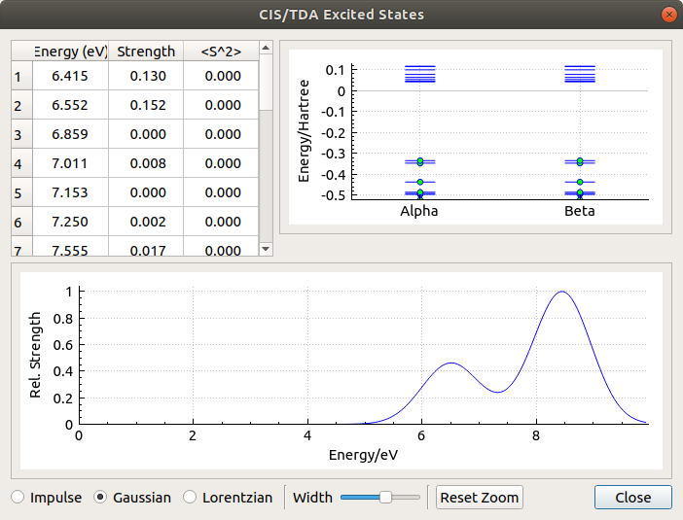
Palmer et al. Chem. Phys. 1999, 275.
Results from our calculation
‹#›

Slide 11
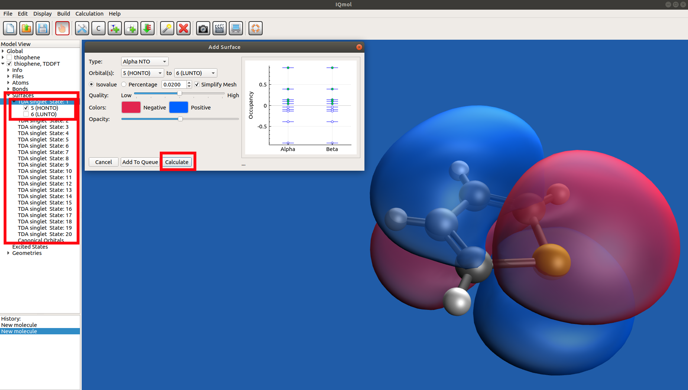
TD-DFT: thiophene
Visualize the orbitals
Click on the “Surfaces” drop- down menu
Double click on the first excited state
Click on “Calculate”
‹#›

Slide 12



